Slide 1
ProviderNet
Customer Discovery
Jaden Del Rosario
Lydia Holleman
Lola Wood

Slide 2
Who we talked to
2 JD candidates studying health law
Trauma nurse educator at a major hospital in Atlanta
Private practice dentist
Cardiovascular tech in hospital in NC

Slide 3
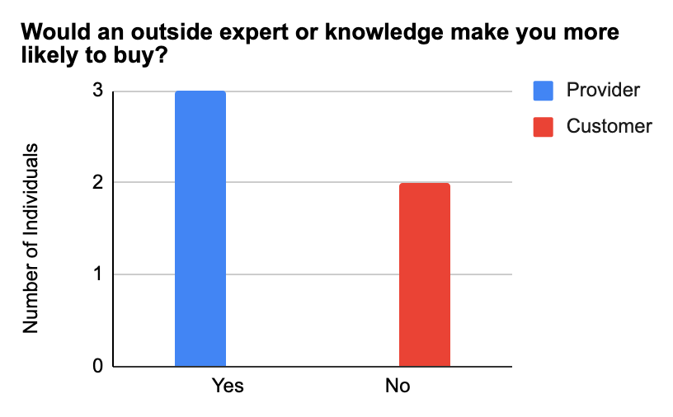

Slide 4
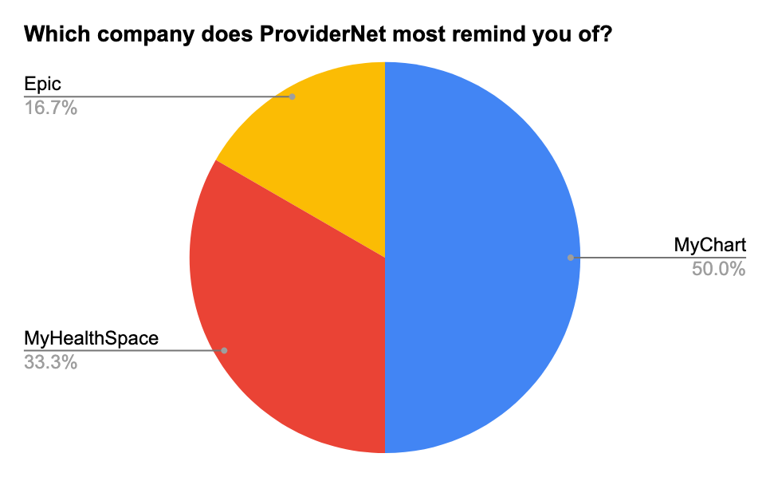

Slide 5
We inquired about HIPAA compliance…

Slide 6
JD Candidates:
“... biggest struggle wouldn’t be HIPAA but having all health care providers using a unified system, if you could it pull off HIPAA likely wouldn’t be that hard... you’d need to make two interfaces, one for patient and one for providers but as long as you follow the HIPAA security rule I don’t see a glaring issue other than it would be large undertaking to move everyone’s data and you’d need patients to agree to move their information to a unified system”
“... need to find a way to make it benefit the provider, they have network wide systems a lot of the time and I don’t think they’d be super motivated to spend time and money to move their PHI solely for the patients benefit so … think of a way to market this as easier or cheaper”
“The MyHealthSpace model has had positive reactions in the medical/law community… the idea is solid you’d just need to follow the statutes about security and Protected Health Information (PHI) and then give all your clients contracts that they’d need their patients approval to put their PHI in it.”
“I don’t think it’s actually that much different than a MyHealthSpace or MyChart. I think your biggest issue would be getting participation because the government could only incentivize and other than that you would need to make it dirt cheap to get rural healthcare providers to participate or to get the competitive edge on the current platforms since it would take a lot of work to move all the PHI”

Slide 7
Downsides to Competitive Software…

Slide 8
Trauma Nurse Educator
Downsides of current EHS:
“You purchase modules for Epic, so not every hospital that uses it has the same features because it is dependent on hospital budget at the time of purchasing. Limits functionality and communication with other hospitals that use the system.”
“Making any changes to the charting system is cumbersome and time consuming. Limits ability for leadership to add functions that would help with regulatory compliance measures. Often the people approving changes are not clinical and therefore don’t understand the utility of these changes.”
“Only certain outside hospitals or providers can access the medical record which does not allow for continuity of care. They have to belong to care everywhere. If they can’t access getting medical records can be timely and ultimately delay treatment.”
I think most people want a system that is intuitive and easy to use for people with varying technological experience. Be able to access even if using another EMR with simple electronic consent.

